Slide 1
Activity 7: FEATURE EXTRACTION
Genesis Vertudez – 202003099
App Physics 157 - Computational Analysis and Modeling in Physics
Submitted to Dr. Maricor Soriano; Mx. Rene Principe Jr.

Slide 2
OBJECTIVES
Extract features of an original image from its cleanly segmented image
Label desired objects in the image

Slide 3
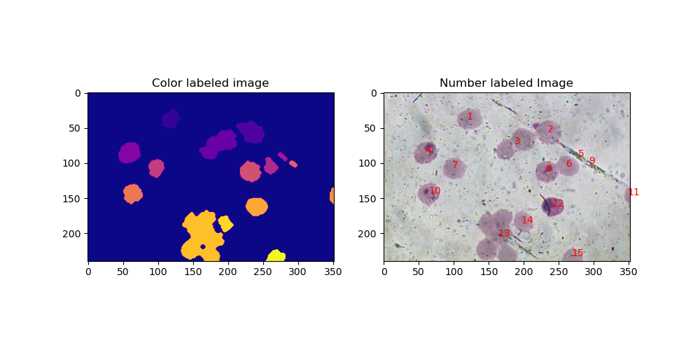
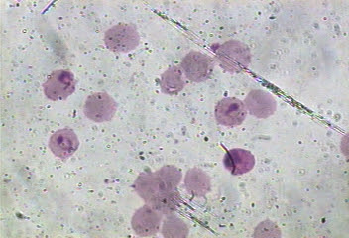
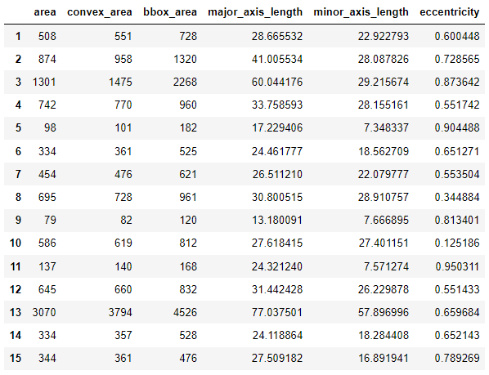

FEATURE EXTRACTION – MALARIA CELLS
Now that we have the cleanly segmented image, we can now extract features from the original image.
Shown on the left again are the original image and the segmented image of the malaria cells.
We can then label each blob of cell individually, with colors or with numbers as shown in the right. The number labels are placed on the centroid of each blob, which is a feature also extracted from it. One cell is counted as one continuous (connected) white patch. Human judgment might suggest that cells number 3 and 13 are actually still a group of cells, which is more likely correct. However, this needs a more advanced methods to actually discern the individual cells in that group.
The image on the right shows the extracted features of each cell, including their area, convex area which is the area of the smallest convex shape that can bound the cell, bounding box area, major and minor axes lengths, and eccentricity which is a measure of roundness.
Labeled image
Original image
Segmented image
Features
Codes and files: https://github.com/genvert/AP_157_FX-2_Vertudez/tree/main/Activity%207

Slide 4
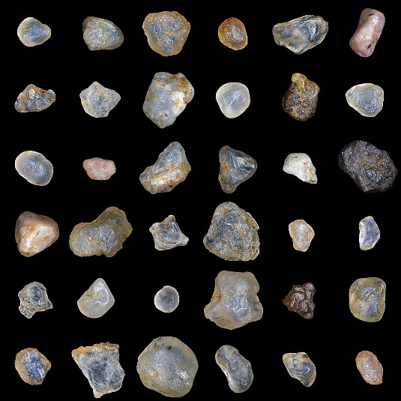
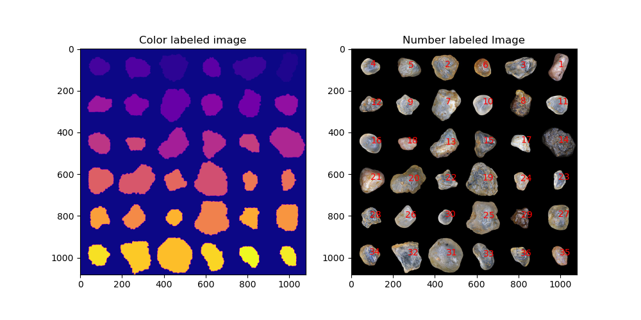

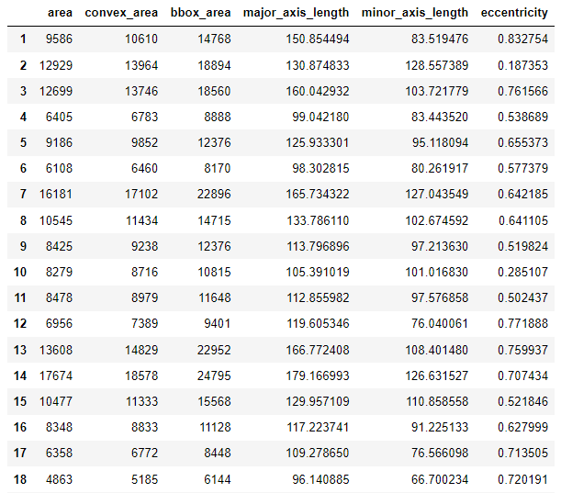
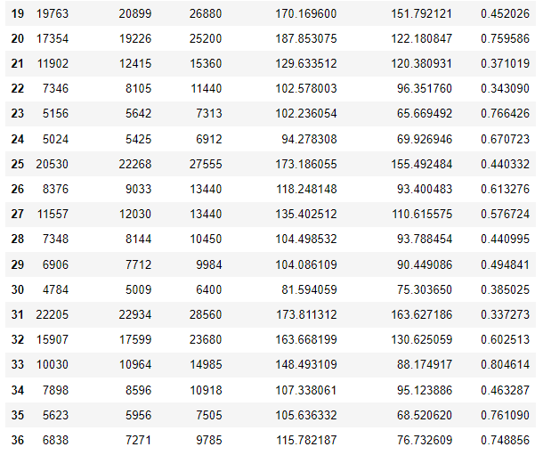
FEATURE EXTRACTION – SAND PARTICLES
Shown on the left again are the original image and the segmented image of the sand particles.
We can then label each particle of sand individually, with colors or with numbers as shown in the right. The number labels are placed on the centroid of each particle, which is a feature also extracted from it. One particle is counted as one continuous (connected) white patch. In this case, the particles are clearly separated so we are certain that there is no overlapping individual particle.
The image on the right shows the extracted features of each cell, including their area, convex area which is the area of the smallest convex shape that can bound the cell, bounding box area, major and minor axes lengths, and eccentricity which is a measure of roundness.
Original image
Labeled image
Segmented image
Features
Codes and files: https://github.com/genvert/AP_157_FX-2_Vertudez/tree/main/Activity%207

Slide 5
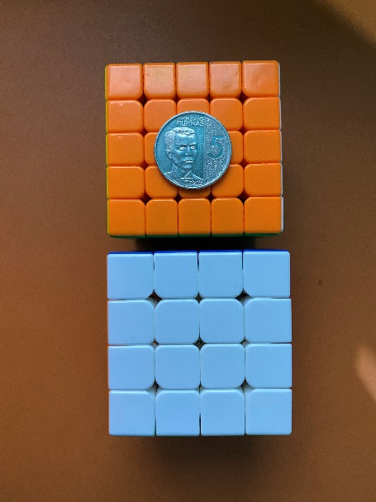
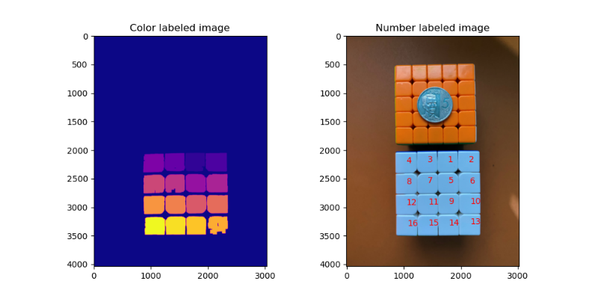
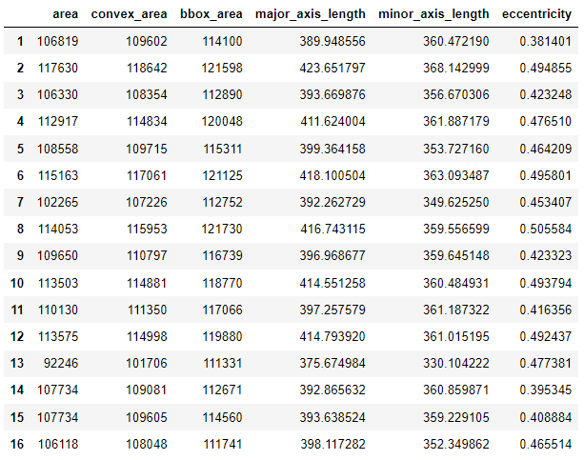
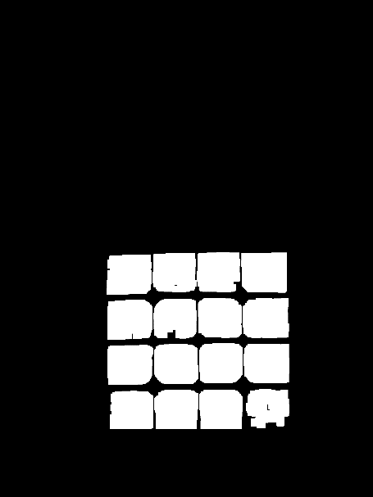
FEATURE EXTRACTION – CUBE
Shown on the left again are the original image and the segmented image of the 4x4x4 Rubik’s cube.
We can then label each piece individually, with colors or with numbers as shown in the right. The number labels are placed on the centroid of each blob, which is a feature also extracted from it. One piece is counted as one continuous (connected) white patch. It might seem that the previously segmented (not yet morphed) is better, but it still shows white patches on the orange cube where there is reflection (top left). Thus, it is necessary to use morphological operators to remove them. Note that from ImageJ, the segmented image actually contains the said noise in the orange cube, but they only labeled the white ones, so it was okay that time.
The image on the right shows the extracted features of each cell, including their area, convex area which is the area of the smallest convex shape that can bound the cell, bounding box area, major and minor axes lengths, and eccentricity which is a measure of roundness.
Labeled image
Original image
Segmented image
Features
Codes and files: https://github.com/genvert/AP_157_FX-2_Vertudez/tree/main/Activity%207

Slide 6
REFLECTION
This activity was very straightforward.
It was fun to see you can automatically extract features from an image after segmenting it cleanly.
This definitely gave me ample idea on how ImageJ extract features from the image since we have done it by parts and explored the mathematics behind them.

Slide 7
SELF-GRADE
Technical correctness: 35/35
I am confident that I understood how to label the original image with colors or with numbers, and to extract features using the cleanly segmented image.
Quality of presentation: 35/35
I have explained each step and idea, and images are clear and concise.
Self-reflection: 30/30
The activity was really fun and straightforward. I gained knowledge behind the ideas on how ImageJ extract features from images.
Initiative: 10/10
I went beyond the expected output by trying the image I used in ImageJ activity.

Slide 8
REFERENCES
[1] Soriano, M. (2023). AP 157 module. Activity 7 - Feature Extraction Part 3 of 3.

